Slide 1


Email Automation for Greeting Employee
Prepared By:
Aarzin Todiwala (201303100910043)
B.Tech (8th Semester) (CE)
CGPIT.
Guided By:
Mr. Fenil Khatiwala
Assistant Professor (CE & IT)
CGPIT.

Slide 2

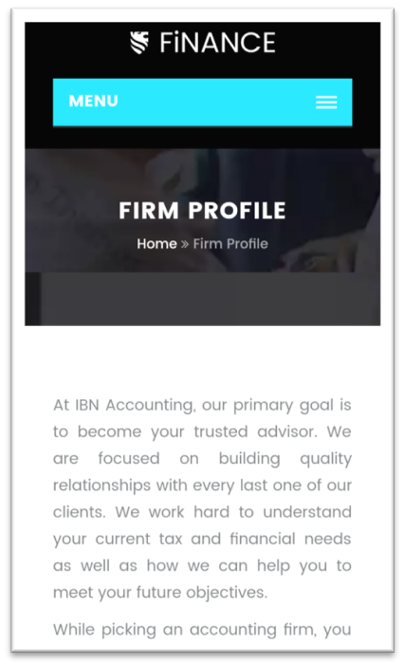
Highlights of Presentation1
Landing Pages and Blogs
Aarzin M. Todiwala(201303100910043)The Industrial Training Presentation CGPIT, May 2017

Slide 3


Training And Other Activities
Training on Wordpress
Graphics Designing
Using Wordpress:
Blogs
Pages
Landing Pages – Sales Page
Menu
Using Photoshop:
Banners for website.
Banners for Blog
icons
Aarzin M. Todiwala(201303100910043)The Industrial Training Presentation CGPIT, May 2017

Slide 4
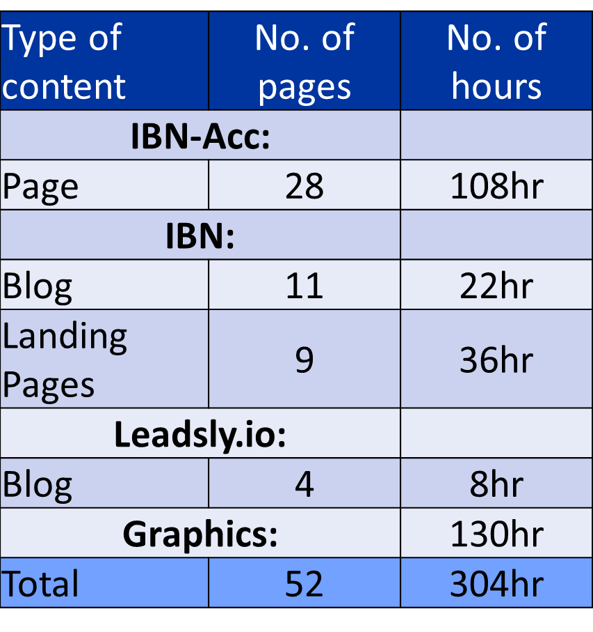
Task Completed Before Presentation1:
Aarzin M. Todiwala(201303100910043)The Industrial Training Presentation CGPIT, May 2016

Slide 5





Timeline Chart
2017
01-01
15-01
29-01
12-02
26-02
12-03
26-03
09-04
23-04
07-05
21-05
2017
Today
Training Phase
(Wordpress)
1/2/2017 - 1/14/2017
Blog & Landing Pages(IBN)
1/18/2017 - 5/31/2017
13 days
Proposal Phase
1/29/2017 - 2/18/2017
134 days
Presentation 1
2/17/2017
Implementation Phase
2/19/2017 - 4/8/2017
21 days
Testing Phase
4/10/2017 - 4/25/2017
1 day
Presentation 2
4/8/2017
49 days
16 days
1 day
Aarzin M. Todiwala(201303100910043)The Industrial Training Presentation CGPIT, May 2017
4

Slide 6
Project Objective:
Welcoming New- Employee
Birthday Graphic
Work-Anniversary Graphic
Aarzin M. Todiwala(201303100910043)The Industrial Training Presentation CGPIT, May 2017

Slide 7
Modules Of Website:
Aarzin M. Todiwala(201303100910043)The Industrial Training Presentation CGPIT, May 2017

Slide 8
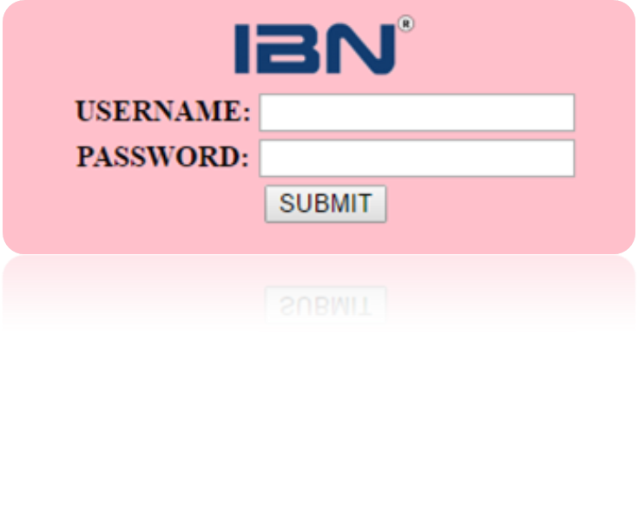
Main Login Page:
Aarzin M. Todiwala(201303100910043)The Industrial Training Presentation CGPIT, May 2017

Slide 9
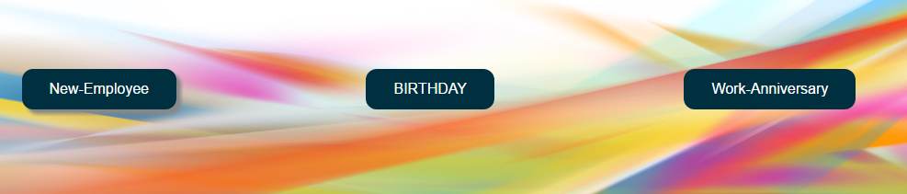
Option Page:
Aarzin M. Todiwala(201303100910043)The Industrial Training Presentation CGPIT, May 2017

Slide 10
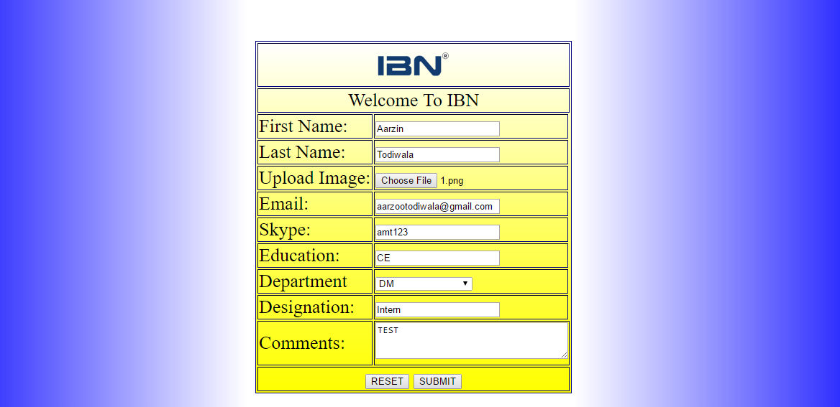
Form Page For Welcoming New Employee:
Aarzin M. Todiwala(201303100910043)The Industrial Training Presentation CGPIT, May 2017

Slide 11
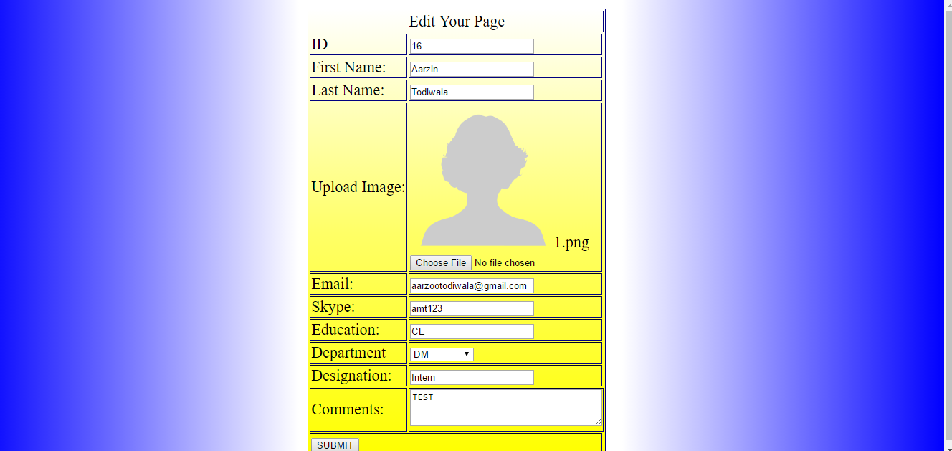
Edit Profile Page:
Aarzin M. Todiwala(201303100910043)The Industrial Training Presentation CGPIT, May 2017

Slide 12
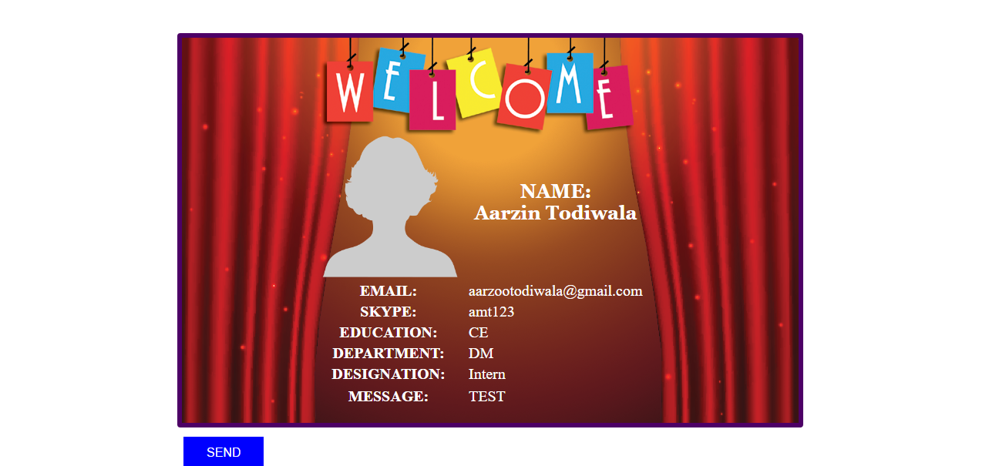
Final Submission Page:
Send Mail:
Aarzin M. Todiwala(201303100910043)The Industrial Training Presentation CGPIT, May 2017

Slide 13
Future Plan:
Completing Birthday and Work-Anniversary Pages.
Completing the rest javascript.
Testing.
Aarzin M. Todiwala(201303100910043)The Industrial Training Presentation CGPIT, May 2017

Slide 14

Aarzin M. Todiwala(201303100910043)The Industrial Training Presentation CGPIT, May 2017

